Slide 1
Introduction to reflections
Transformations

Slide 2
how to use Oak lessons

Slide 3
I can understand the nature of reflections and appreciate what changes and what is invariant.

Slide 4
A reflection of a shape is the mirror image of the shape. An object is reflected when it is flipped over a fixed line (called the line of reflection), without the image being turned or its size changing.
The sense of an object is the direction of the orientation of the object. When the sense of an object changes, the direction of its orientation changes from clockwise to anti-clockwise, or vice versa.

Slide 5

Introduction to reflections
Understanding transformations and sense
Understanding properties of reflection

Slide 6
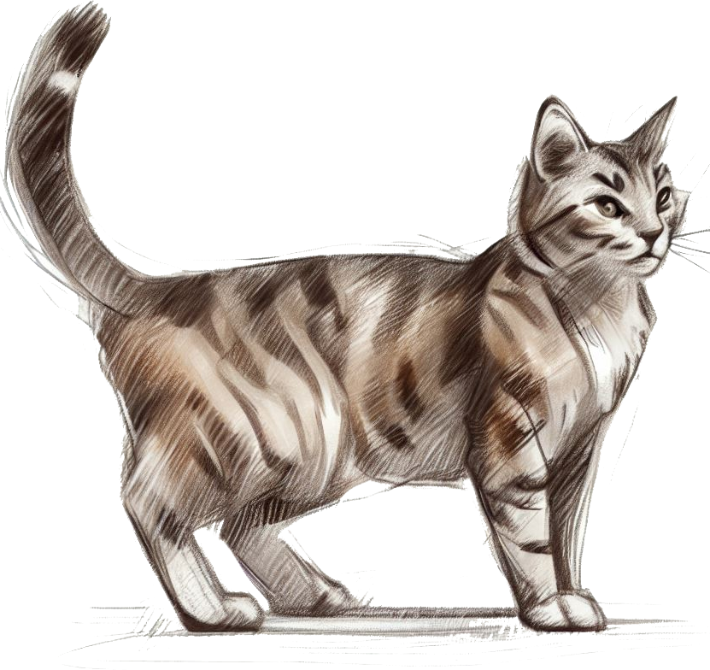

Understanding transformations and sense
Which of these shows a reflection?

Slide 7
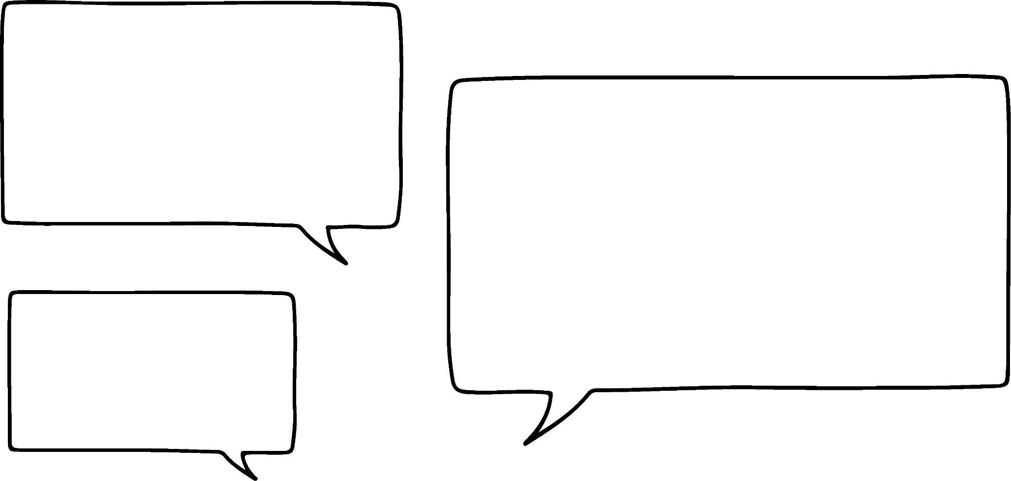

Understanding transformations and sense
What words do you associate with reflection?
Flip
Mirror
Equidistant
The reflection is a mirror image of the cat.
The image of the cat has flipped in the reflection.
Sam

Slide 8

Understanding transformations and sense
Which of these words has been reflected, and which have been rotated?
How can you tell?
What strategies could you use to make some words more readable?
You can tilt your head left and right to help read the first and last words.

Slide 9
Understanding transformations and sense
The sense of an object
An object maintains sense after a transformation has been applied if: the object is still identifiable as exactly the same object without any further transformations being applied.
Which transformations maintain sense?
All transformations maintain the sense of an object, except for one…
reflection

Slide 10
Understanding transformations and sense
How does translation maintain sense?
As a word is translated, you can still identify the letters in the word.
It is still as readable as it was before moving.

Slide 11

Understanding transformations and sense
How does rotation maintain sense?
As a word is rotated, you can still identify the letters in the word.
It might become more difficult to read the word as the rotation gets closer to a 180° rotation, but you can tilt your head left or right to help with this.
Because you can tilt your head to make the letters look like they were before, the sense of the letters has remained.

Slide 12
Understanding transformations and sense
Why does reflection not maintain sense?
FROG
When a word has been reflected, the letters of the word will have been transformed in a way that makes it impossible to identify as the same letter, no matter how much you tilt your head.
The sense of those letters has changed, because it will never look like the original again without another reflection.
Can you tilt your head to make the letter F look like this?
F

Slide 13

Understanding transformations and sense
Why does reflection not maintain sense?
FROG
Some letters, like the O in frog, might still look the same, but their sense has still changed.
This becomes more visible if you mark the letter O in a different font.
FROG

Slide 14
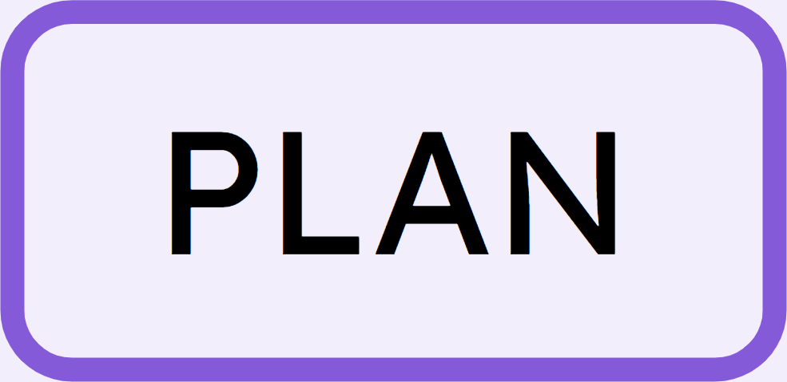
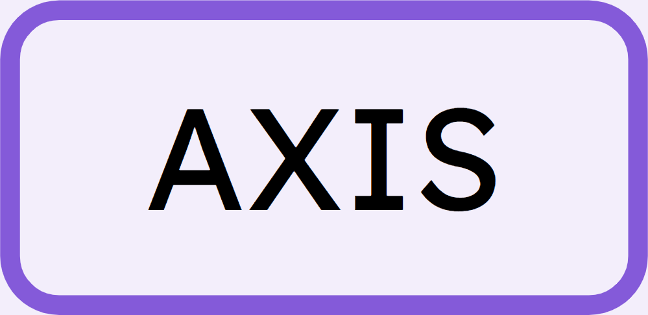
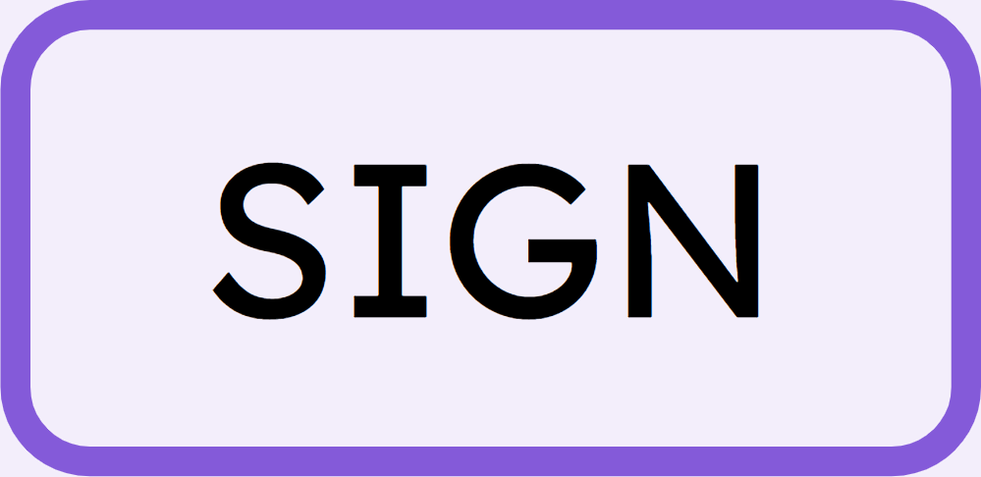


Understanding transformations and sense
In which of these pairs of words has the sense changed?

Slide 15
Understanding transformations and sense
In which of these pairs of words has the sense changed?

Slide 16
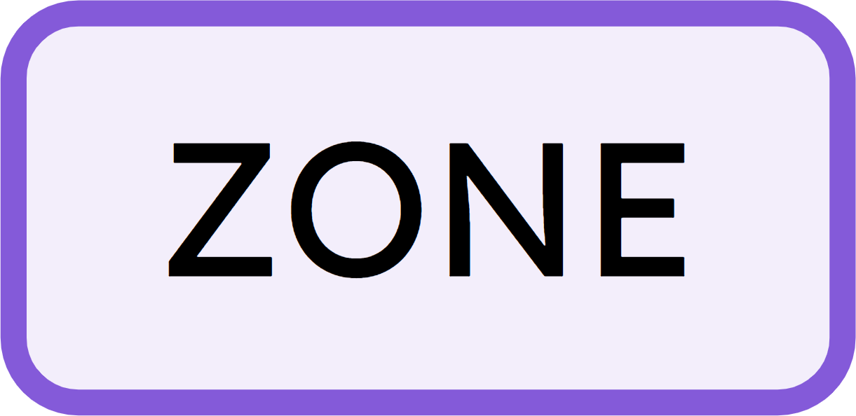
Understanding transformations and sense
1) In which of these images has the sense changed (due to reflection)?
2) For the non-reflections, state whether they are translations or rotations.
object
ZONE

Slide 17
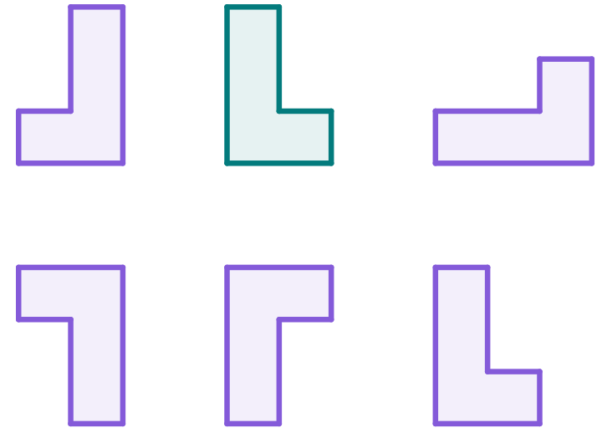
Understanding transformations and sense
3) In which of these images has the sense changed (having been reflected)?
4) For the non-reflections, state whether they are translations or rotations.
object

Slide 18
Understanding transformations and sense
1) In which of these images has the sense changed (due to reflection)?
2) For the non-reflections, state whether they are translations or rotations.
object
ZONE
rotation
translation
rotation

Slide 19
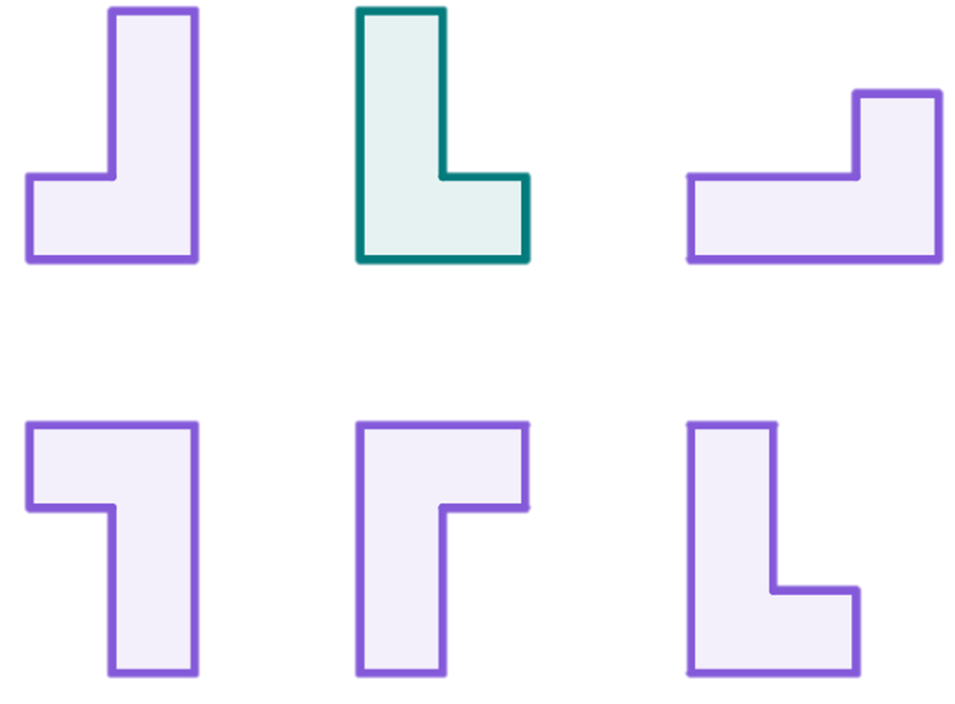
Understanding transformations and sense
3) In which of these images has the sense changed (having been reflected)?
4) For the non-reflections, state whether they are translations or rotations.
object
rotation
rotation
translation

Slide 20
Introduction to reflections
Understanding transformations and sense
Understanding properties of reflection

Slide 21
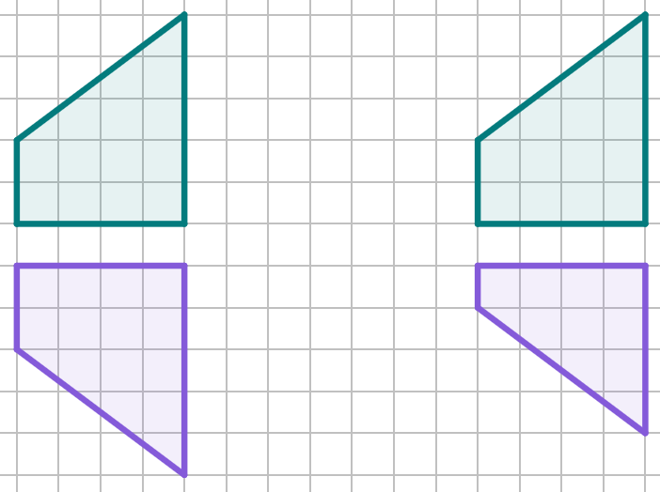
Understanding properties of reflection
When an object is reflected, the lengths of the sides are invariant, but the sense of the sides will always change.
Which of these is an example of a reflection, and which is a non-example?
object
object
All sides remain the same length, but some have changed their location.
The height of the object was at its maximum 5 units.
However, the height of the image is only 4 units.
image
image
example of reflection
non-example

Slide 22
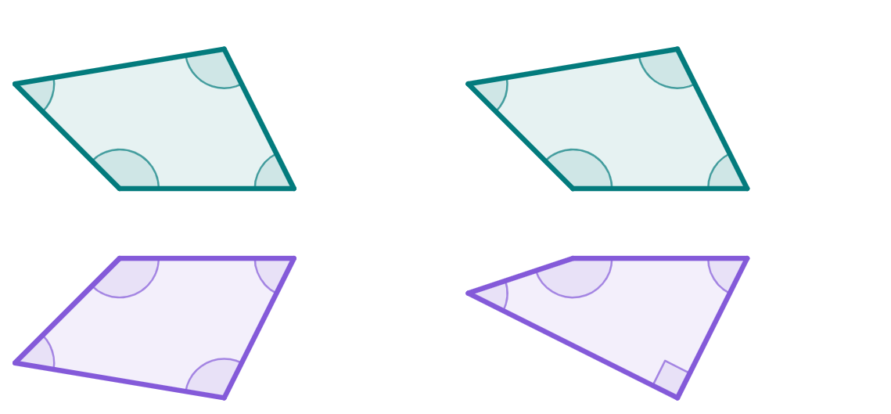
Understanding properties of reflection
When an object is reflected, the angles within the shape are always invariant.
Which of these is an example of a reflection, and which is a non-example?
object
object
55°
107°
55°
107°
135°
135°
63°
63°
63°
image
45°
162°
63°
135°
image
55°
107°
90°
example of reflection
non-example

Slide 23
Understanding properties of reflection
When an object is reflected, its orientation always changes, even if the image looks the same as its object.
object
image
D
C
D′
C′
This is easier to see if we label the vertices of the object and image.
A
B
A′
B′
object
image

Slide 24
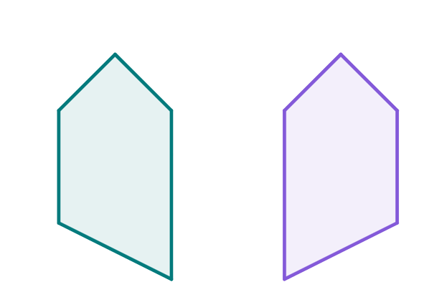
Understanding properties of reflection
This pentagon has been reflected.
Complete the labelling of the vertices of the image.
A
A′
B
E
E′
B′
C
C′
D
D′

Slide 25
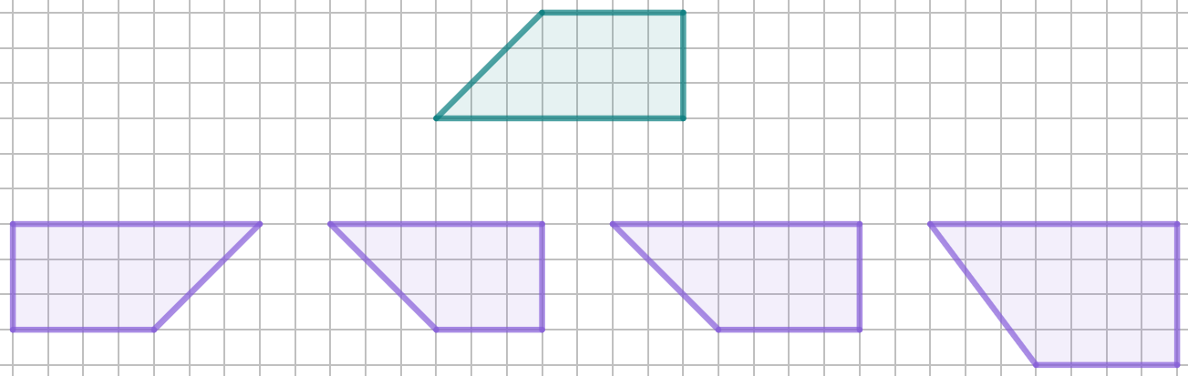

Understanding properties of reflection
Which of these images is a reflection of this quadrilateral?
object
a
b
c
d

Slide 26

Understanding properties of reflection
Sofia’s statement is incorrect.
Come up with an explanation, or draw a reflection, to show she is incorrect.
If you reflect the arrow, it will have the same orientation as it will still face in the same direction.
Sofia

Slide 27
Understanding properties of reflection
Sofia’s statement is incorrect.
Sofia is incorrect because all reflections change orientation, even if the image looks the same.
You can also reflect horizontally so the arrow points left, not right.
If you reflect the arrow, it will have the same orientation as it will still face in the same direction.
Sofia

Slide 28
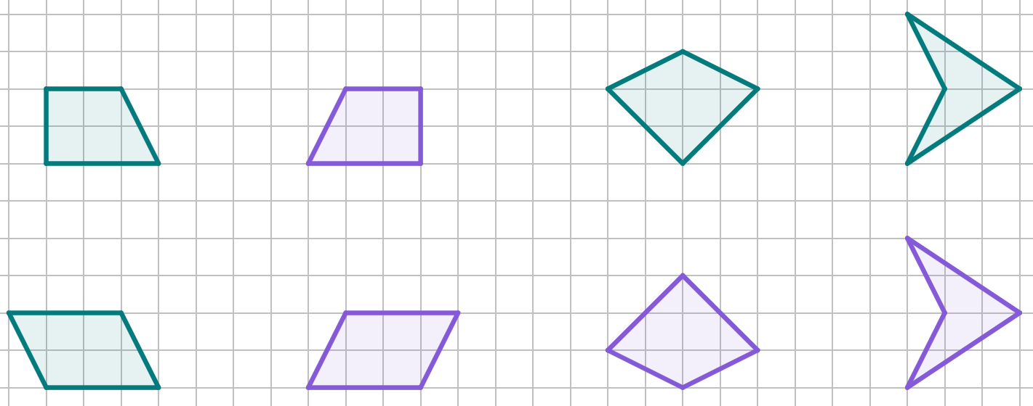
Understanding properties of reflection
1) Each object has been reflected.
Complete the labelling of the vertices of each image.
M
I
B
A
A′
J
L
N
P
C
D
O
C′
K
F
E
F′
P′
J′
G
H

Slide 29
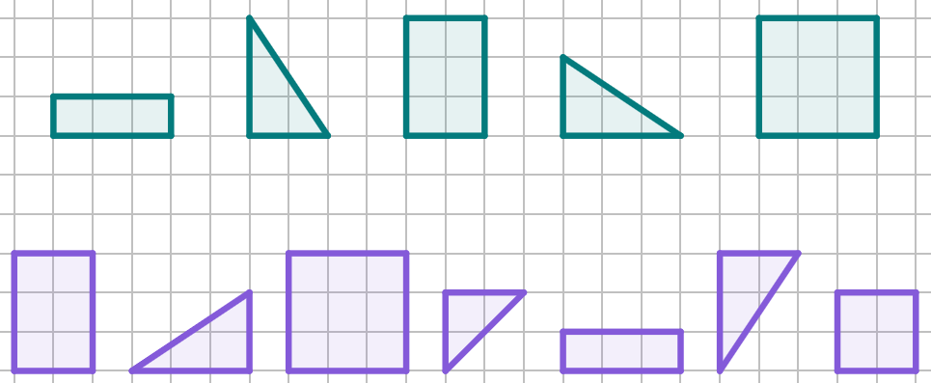
Understanding properties of reflection
2) Match the objects to their reflections.
There are two images that do not pair with an object.
a
b
c
d
e
objects
images
f
g
h
i
j
k
l

Slide 30
Understanding properties of reflection
3) Complete the table with to show the properties of reflection.
 | Always Invariant | Usually Changes
Lengths of Sides
Size of Angles
Position
Orientation
Sense

Slide 31
Understanding properties of reflection
1) Each object has been reflected.
Complete the labelling of the vertices of each image.
M
I
B
A
A′
B′
J
L
N
P
C
D
D′
O
C′
K
O′
K′
F
E
E′
F′
N′
P′
J′
L′
H′
G′
M′
G
H
I′

Slide 32

Understanding properties of reflection
2) Match the objects to their reflections.
There are two images that do not pair with an object.
a
b
c
d
e
objects
c
e
b
d
a
images
f
g
h
i
j
k
l

Slide 33
Understanding properties of reflection
3) Complete the table with to show the properties of reflection.
 | Always Invariant | Usually Changes
Lengths of Sides
Size of Angles
Position
Orientation
Sense

Slide 34
Introduction to reflections
Using the readability of words after a reflection has occurred can be helpful in understanding the meaning and implication of sense.
Sense always changes when an object has been reflected.
Understanding the properties of reflection is important in distinguishing between reflections and non-reflections.

Slide 35

© Oak National Academy 2023.
Produced in partnership with Mathematics in Education and Industry.
Licensed on the Open Government Licence v3.0, except where otherwise stated. See Oak terms and conditions.

